Slide 1

Convolutional Neural Networks in TensorFlow
Notes:
1

Slide 2
Objectives
Understand CNN in TensorFlow
Implement the CNN model for classification
Convolutional Neural Networks in TensorFlow
2

Slide 3
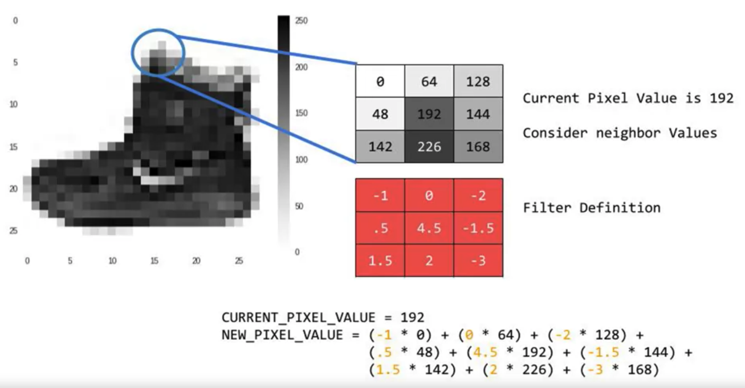
Convolutions
Change the image in such a way that certain features in the image get emphasized
Convolutional Neural Networks in TensorFlow
3
Notes:
3

Slide 4
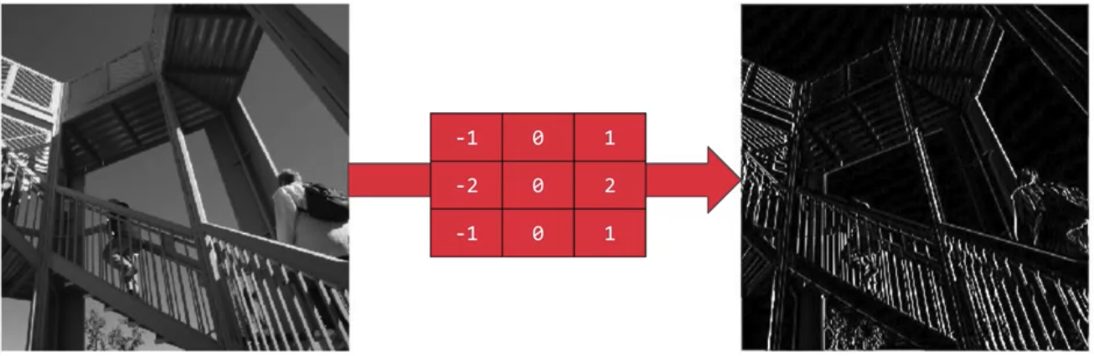
Convolutions
This filter, then the vertical lines in the image really pop out
Convolutional Neural Networks in TensorFlow
4
Notes:
4

Slide 5
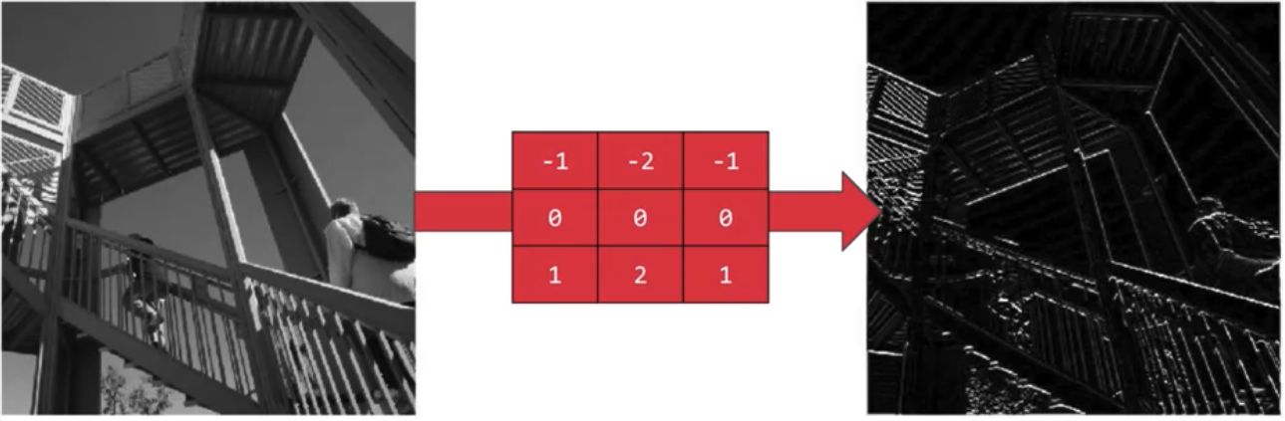
Convolutions
This filter, the horizontal lines pop out
Convolutional Neural Networks in TensorFlow
5
Notes:
5

Slide 6
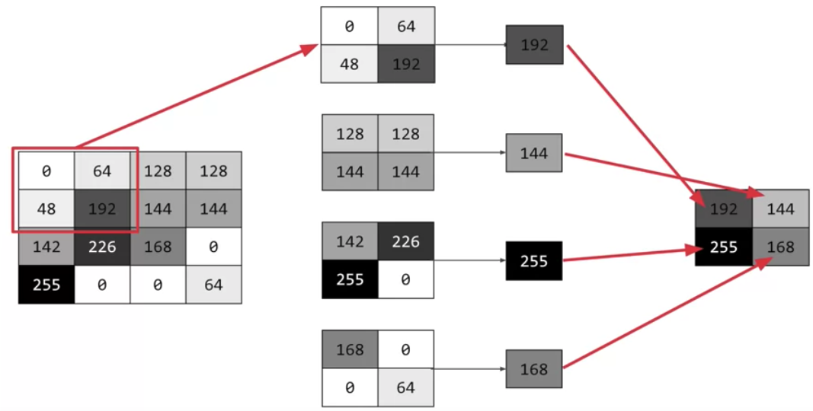
Pooling
Pooling is a way of compressing an image
What kind of this pooling?
Convolutional Neural Networks in TensorFlow
6
Notes:
6

Slide 7
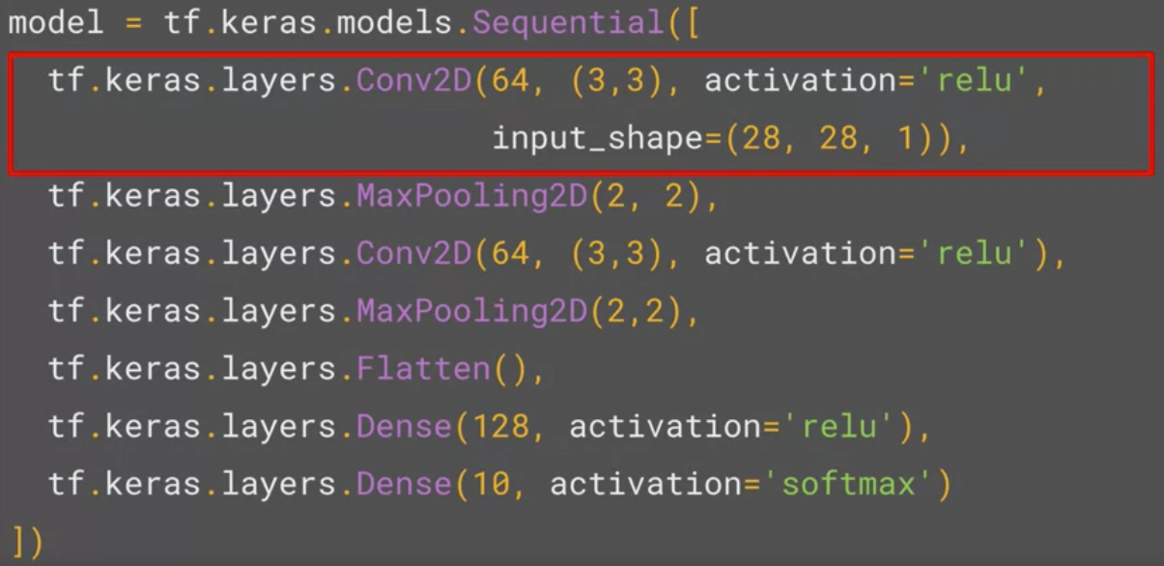
Implementing Convolutional layers
  We're asking keras to generate 64 filters.
  These filters are 3 by 3
  Their activation is relu→ the negative values will be thrown way
  The input shape is as before, the 28 by 28.
  That extra 1 just means that we are tallying using a single byte for color depth.
Convolutional Neural Networks in TensorFlow
7
Notes:
7

Slide 8
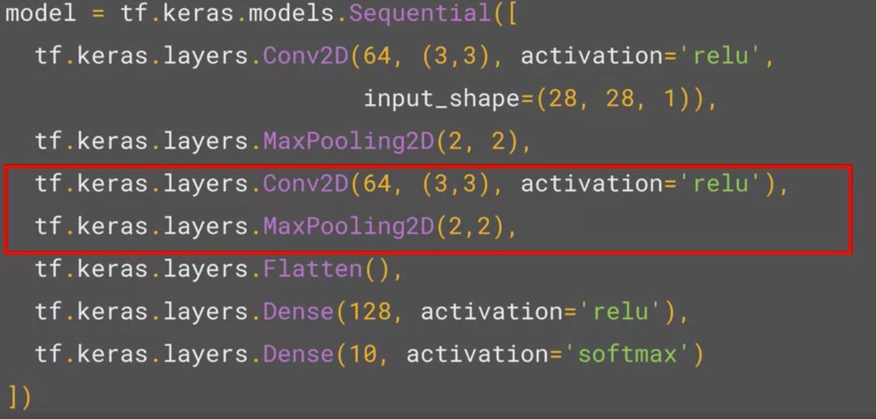
Implementing Pooling layers
  Max Pooling: two-by-two pool, so for every four pixels, the biggest one will survive
Convolutional Neural Networks in TensorFlow
8
Notes:
8

Slide 9
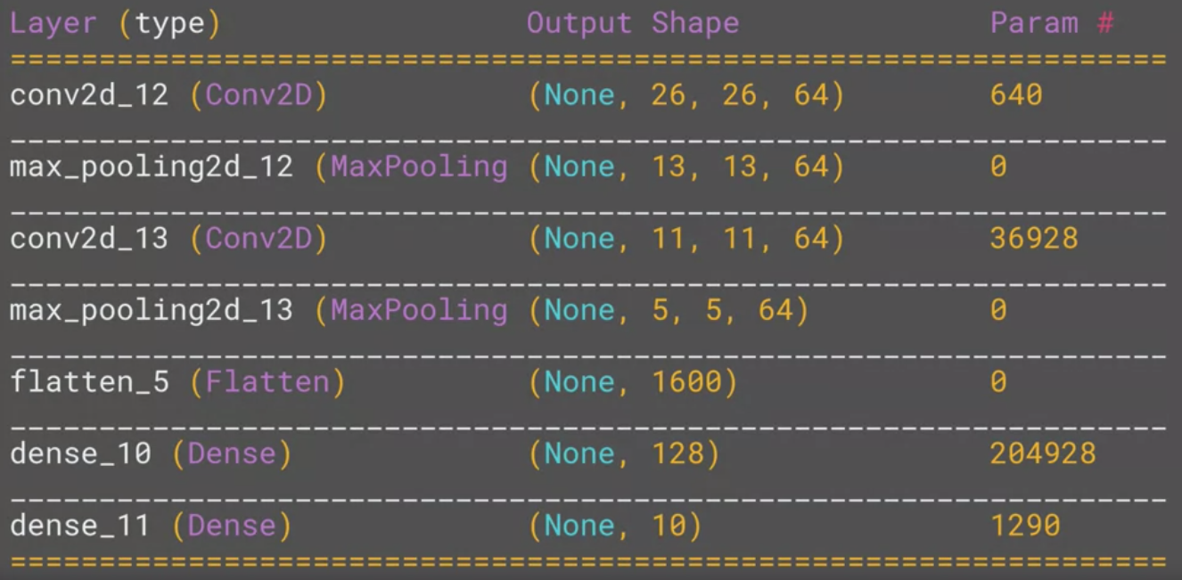
Model.summary()
Inspect the layers of the model, and see the journey of the image through the convolutions
Convolutional Neural Networks in TensorFlow
9
Notes:
9

Slide 10
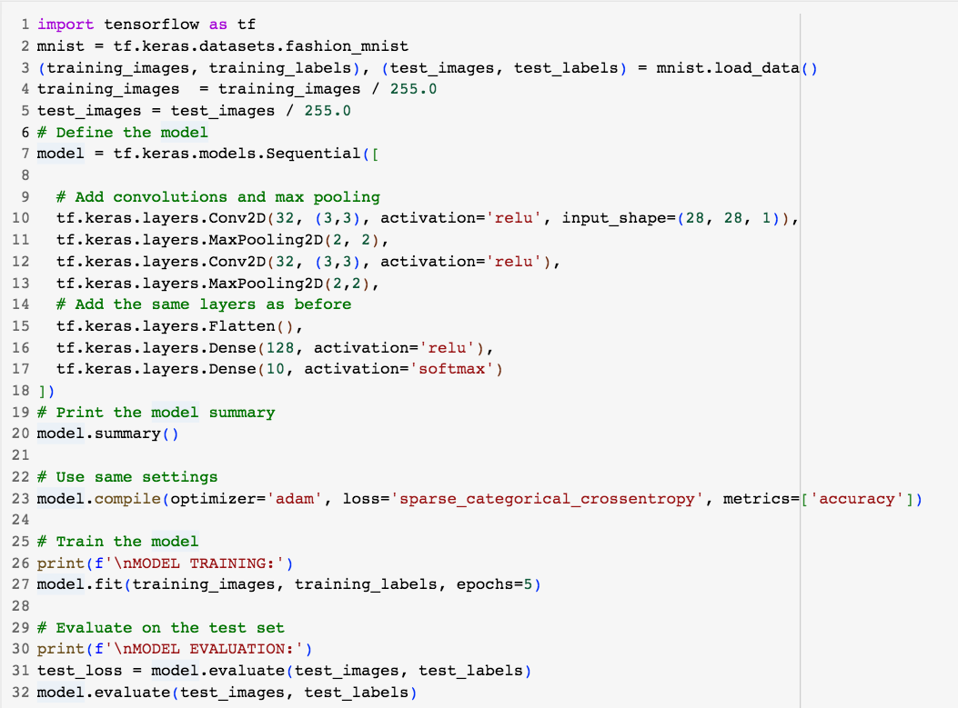
Fashion classifier with convolutions
,Verbose =1
Convolutional Neural Networks in TensorFlow
10
Notes:
10

Slide 11
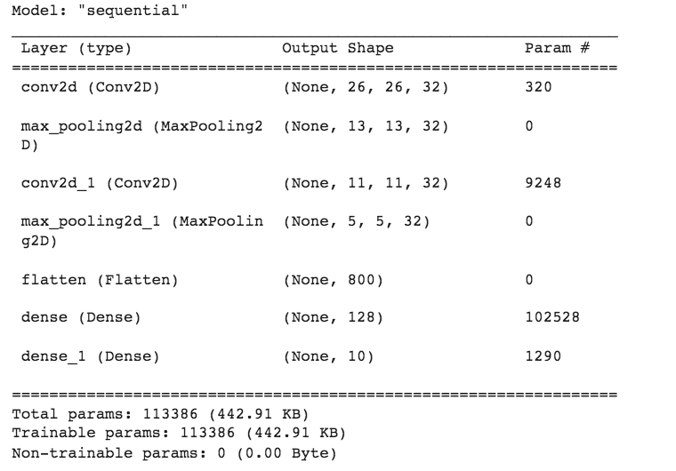
Fashion classifier with convolutions
Convolutional Neural Networks in TensorFlow
11
Notes:
11

Slide 12
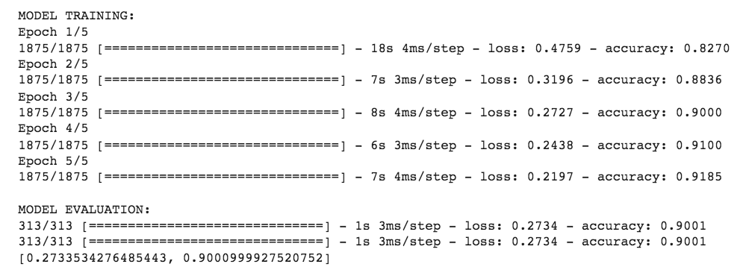
Fashion classifier with convolutions
Convolutional Neural Networks in TensorFlow
12
Notes:
12

Slide 13
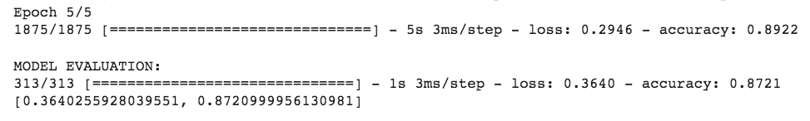
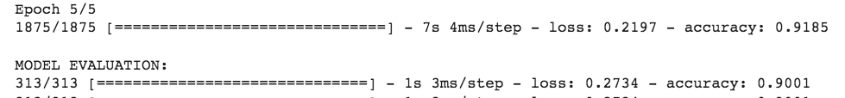
Neural network & Convolutinal
Neural Network
Convolutional Neural Network
Discuss and give your opinions.
Convolutional Neural Networks in TensorFlow
13
Notes:
13

Slide 14
Summary
Understand CNN in TensorFlow
Implement the CNN model for classification
Convolutional Neural Networks in TensorFlow
14

Slide 15
Q & A
Convolutional Neural Networks in TensorFlow
15

